Slide 1
MatRaptor: A Sparse-Sparse Matrix Multiplication Accelerator Based on Row-Wise Product
Nitish Srivastava, Hanchen Jin, Jie Liu, David Albonesi, and Zhiru Zhang
Qun Lou
Nov 29, 2021
https://www.microarch.org/micro53/papers/738300a766.pdf

Slide 2

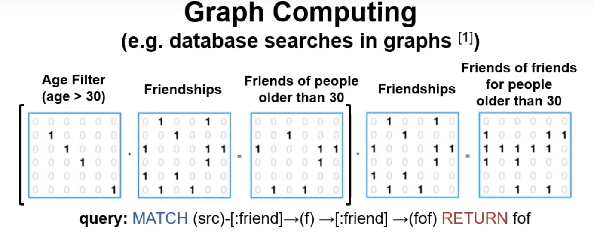
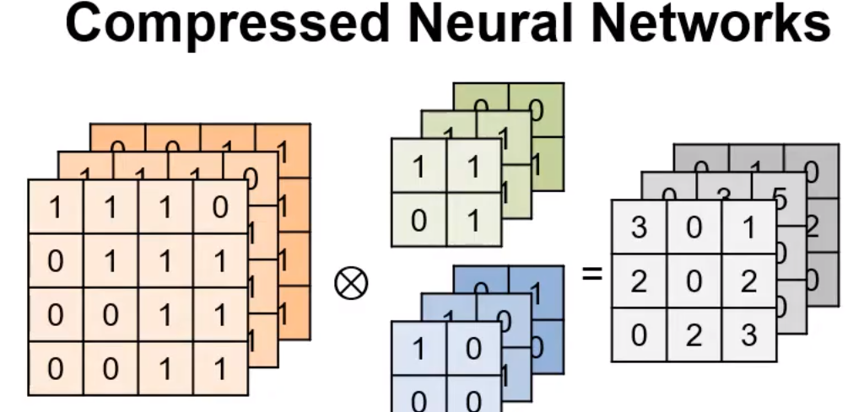
《MatRaptor: A SpGEMM Accelerator Based on Row-Wise Product》
Motivation:
Many applications of SpGEMM
....... Many examples

Slide 3
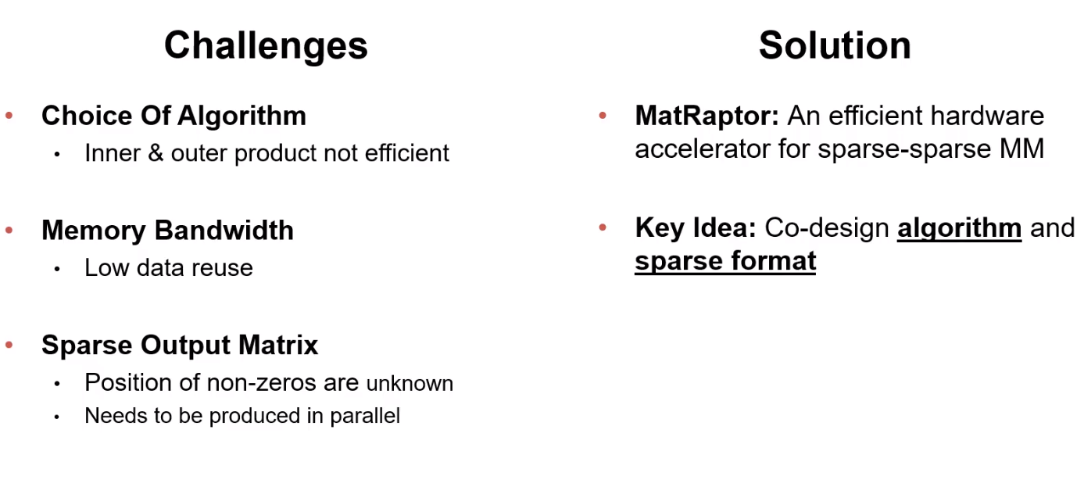
Acceleration for SpGEMM : Challenges && Solution

Slide 4
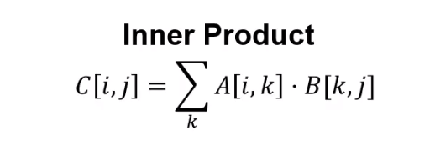
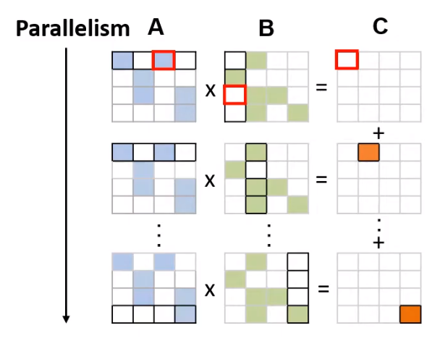
Traditional Approaches : Inner Product
The Bad:
1) Inconsistent formatting
2) Inefficient index-matching
The Good:
1)No synchronization
2)Low memory requirements

Slide 5
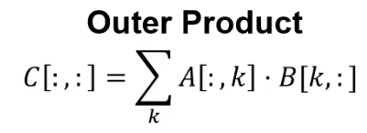
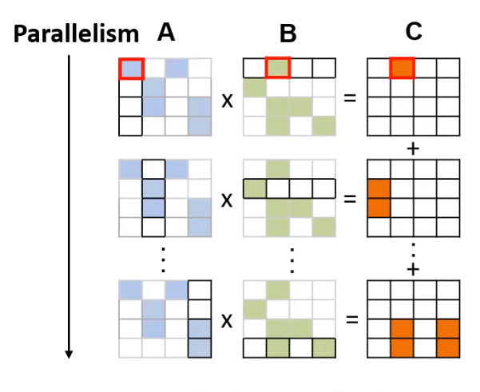
Traditional Approaches : Outter Product
The Bad:
1) Inconsistent formatting
2) Synchronization
3) High memory requirements
The Good:
1)Efficient index-matching

Slide 6
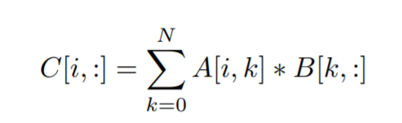
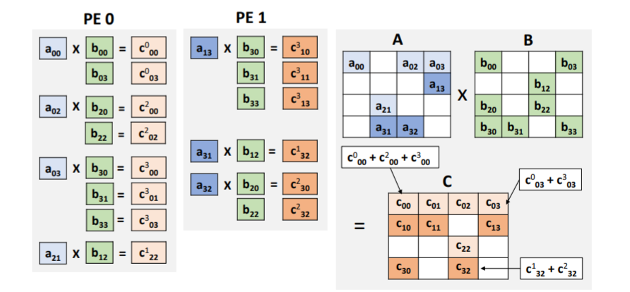
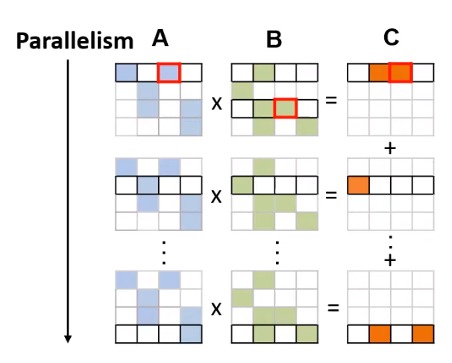
Algorithm : Row-Wise Product
The Good:
1) Consistent Formatting
2) Elimination of Index Matching
3) Elimination of Synchronization
4) Low On-Chip Memory Requirements
The Bad:
1) Low data-reuse
2) Load imbalance

Slide 7
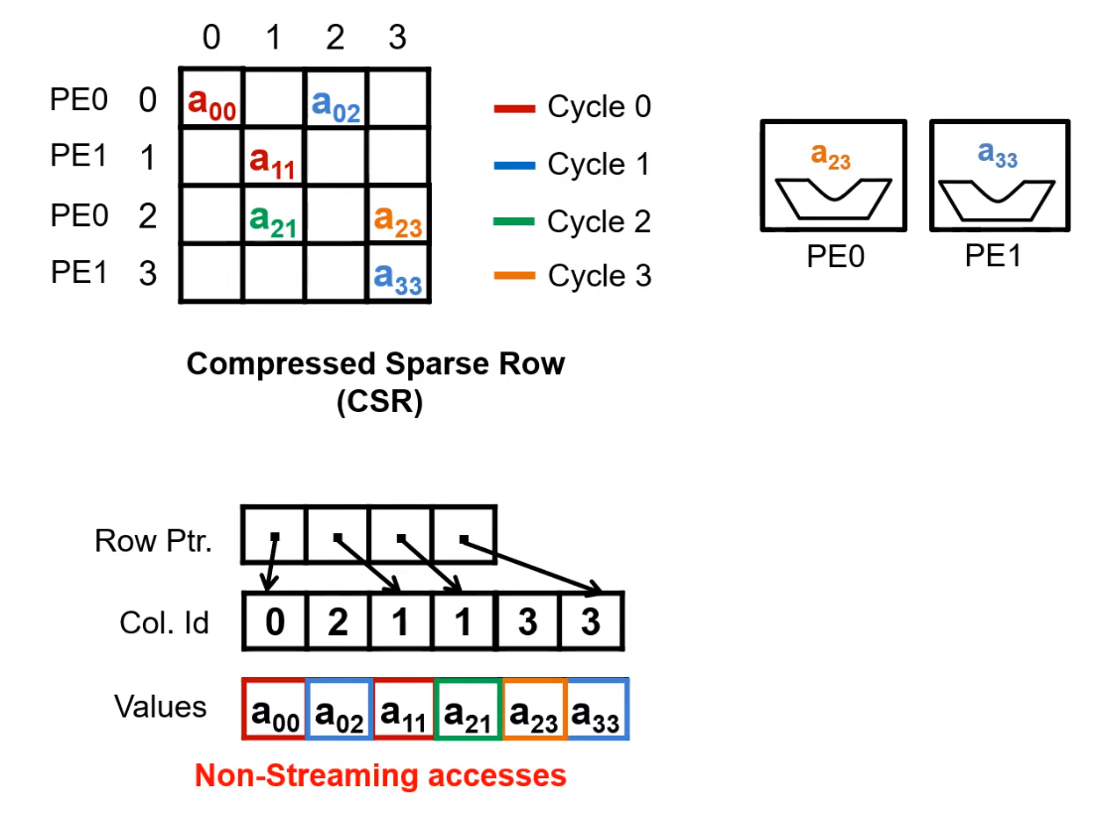
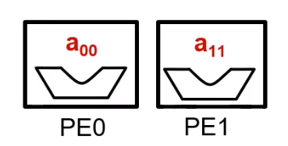
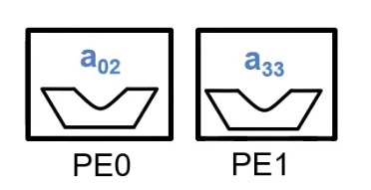
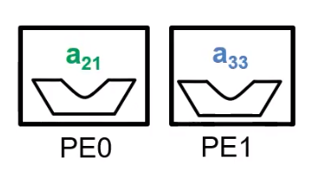
Sparse Format : CSR not works well (for row-wise product)
PE:Processing Engine
Memory Access is not continuous!
the utilization of memory bandwidth will be really low.

Slide 8
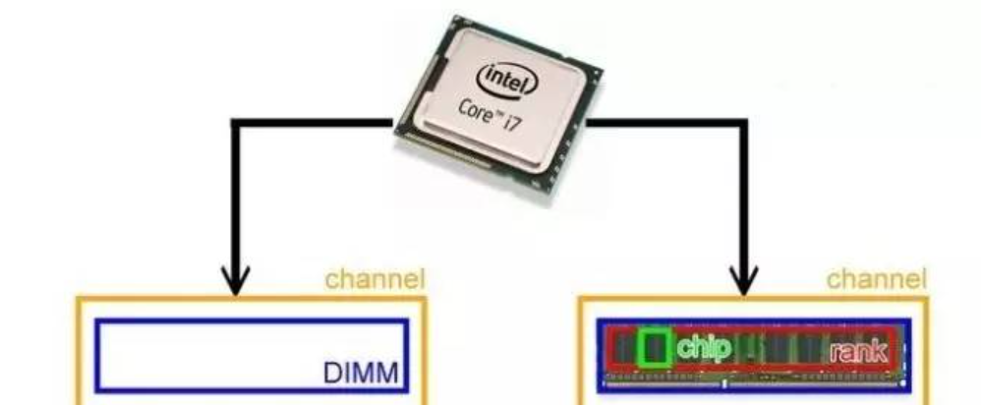
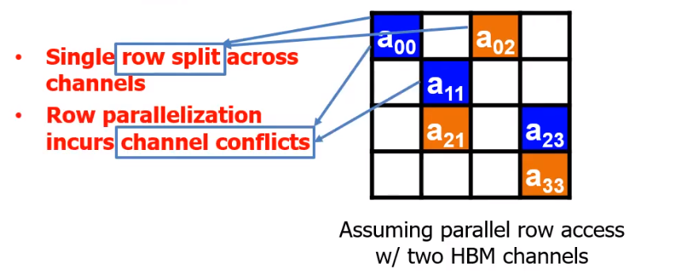
Sparse Format : CSR not works well
It also hampers memory-level parallelism because of channel confilicts
Channel Conflict: two memory access requests are directed to the same controller, the hardware serializes the access.

Slide 9
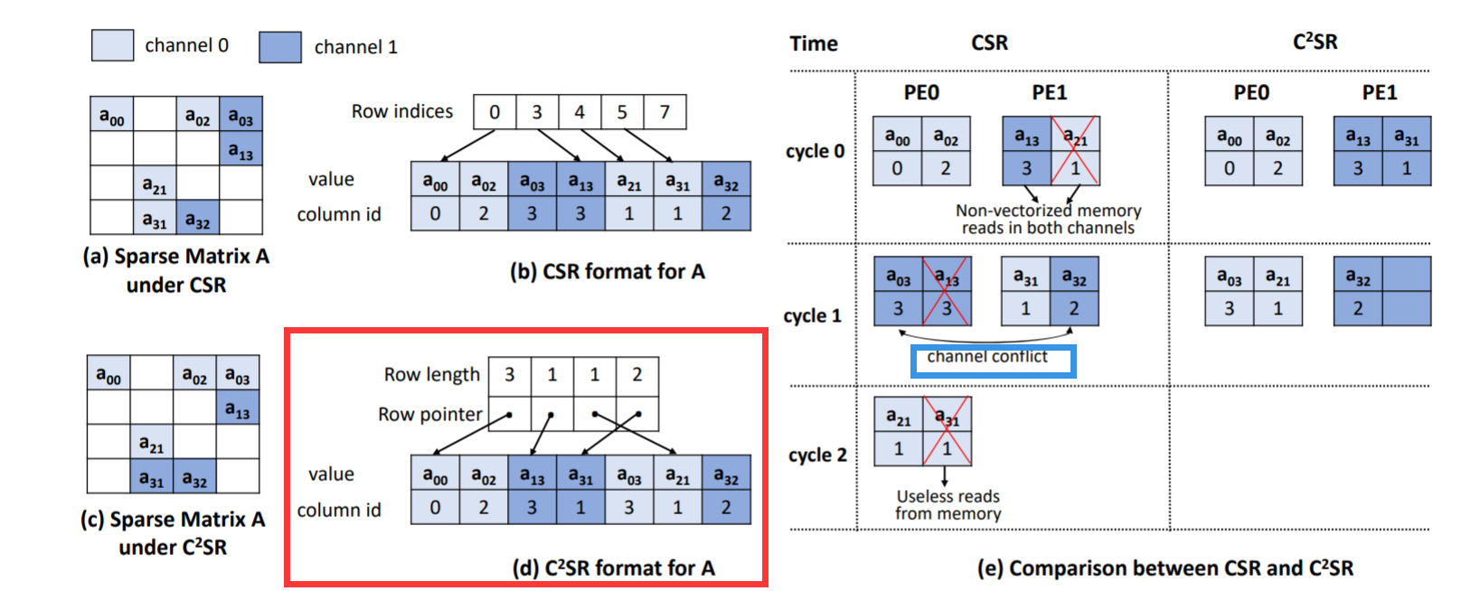
New Format : Channel Cyclic Sparse Row!
(row length,row pointer)-> (value, column id)
Each row is assigned to a fixed channel in a cyclic manner and then for each channel all non-zero elements are written serially to the memory locations corresponding to that channel in the (value, column id) array.
Notes:
Each row is assigned a fixed channel in a cyclic manner.
This new format consists of an array of (row length, row pointer) pairsand an array of (value, column id) pairs. The (value, column id) array stores the non-zero elements from the sparse matrix along with their column ids.
The ith entry in the (row length, row pointer) array stores the number of non-zeros in the ith row and the pointer to the first non-zero element from that row in the (value, column id) array.

Slide 10
New Format : Channel Cyclic Sparse Row!
The Good:
1. No Channel Conflicts (Each row is assigned to a unique channel)
2. Vectorized and Streaming Memory Reads
(All the rows mapped to a channel are stored sequentially in that channel, resulting in high spatial locality when accessing these rows in a row major order)
3. Parallel Writes to the Output Matrix
(The rows of the sparse matrix mapped to a channel can be written to that channel without requiring any information about the rows mapped to other channels)
Notes:
Each row is assigned a fixed channel in a cyclic manner.
This new format consists of an array of (row length, row pointer) pairsand an array of (value, column id) pairs. The (value, column id) array stores the non-zero elements from the sparse matrix along with their column ids.
The ith entry in the (row length, row pointer) array stores the number of non-zeros in the ith row and the pointer to the first non-zero element from that row in the (value, column id) array.

Slide 11
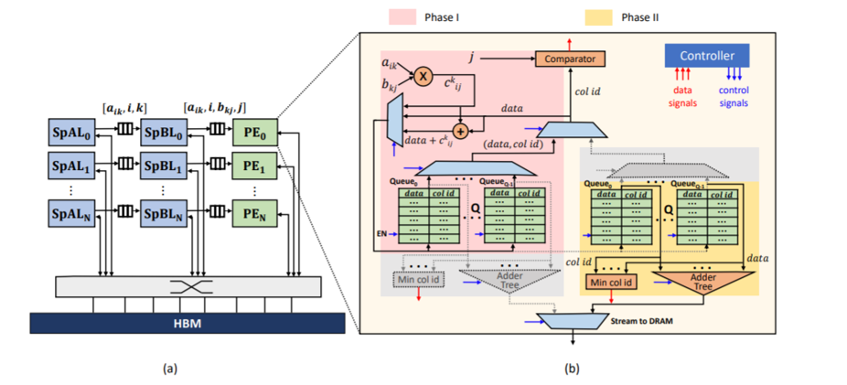
Hardware : MATRAPTOR ARCHITECTURE
A. Row-wise Product Implementation
B. Architectural Details of MatRaptor
A’s Loader, B’s Loader, PE.
Notes:
Each row is assigned a fixed channel in a cyclic manner.
This new format consists of an array of (row length, row pointer) pairsand an array of (value, column id) pairs. The (value, column id) array stores the non-zero elements from the sparse matrix along with their column ids.
The ith entry in the (row length, row pointer) array stores the number of non-zeros in the ith row and the pointer to the first non-zero element from that row in the (value, column id) array.

Slide 12
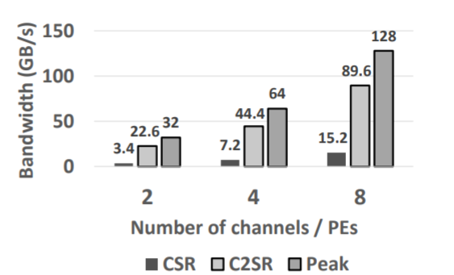
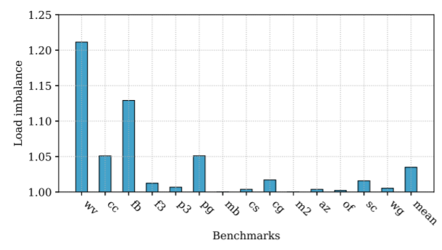
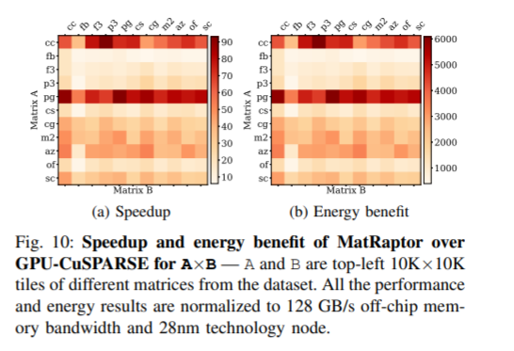
EVALUATION:
Use cuSPARSE to evaluate the benchmarks on an NVIDIA Titan Xp GPU
Notes:
Each row is assigned a fixed channel in a cyclic manner.
This new format consists of an array of (row length, row pointer) pairsand an array of (value, column id) pairs. The (value, column id) array stores the non-zero elements from the sparse matrix along with their column ids.
The ith entry in the (row length, row pointer) array stores the number of non-zeros in the ith row and the pointer to the first non-zero element from that row in the (value, column id) array.

Slide 13

Conclusion
1) Algorithm: Row-Wise Product
2) Format: Channel Cyclic Sparse Row
3) Hardware Architecture: MapRaptor

